Slide 1
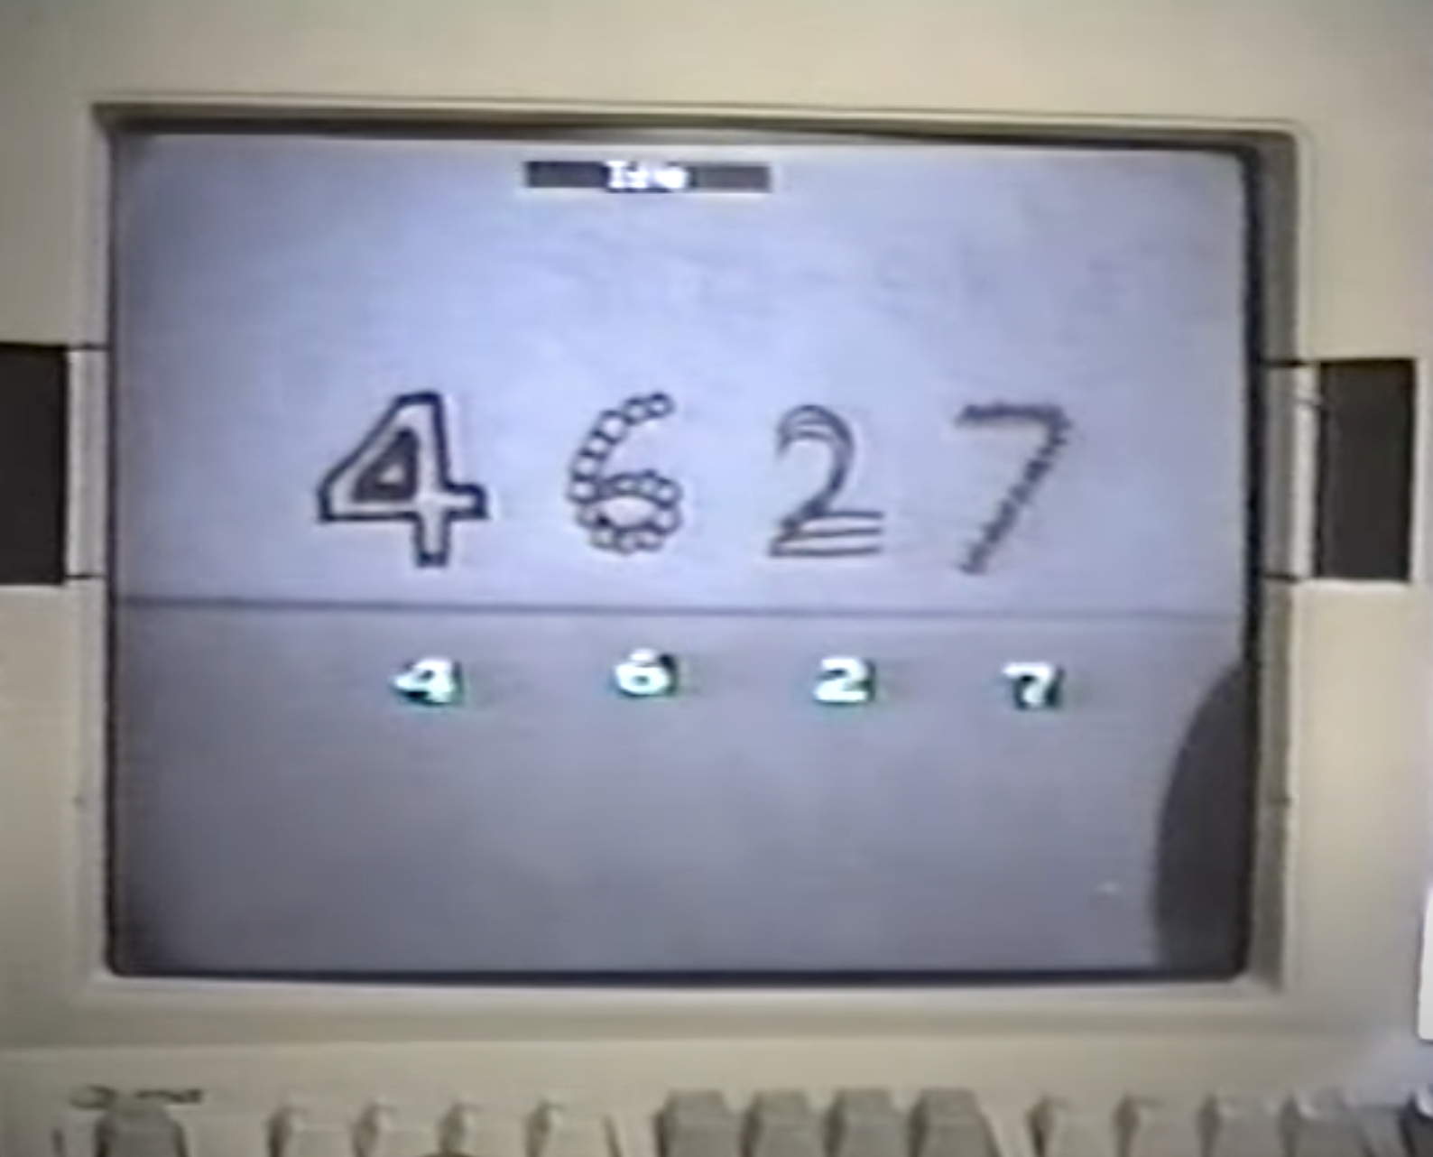
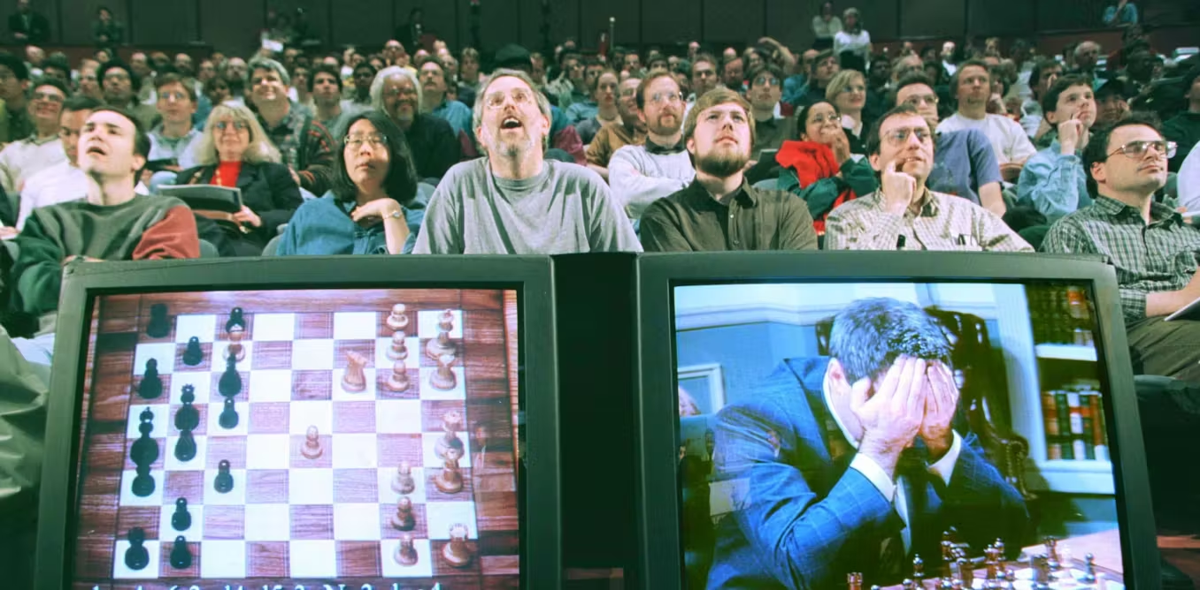

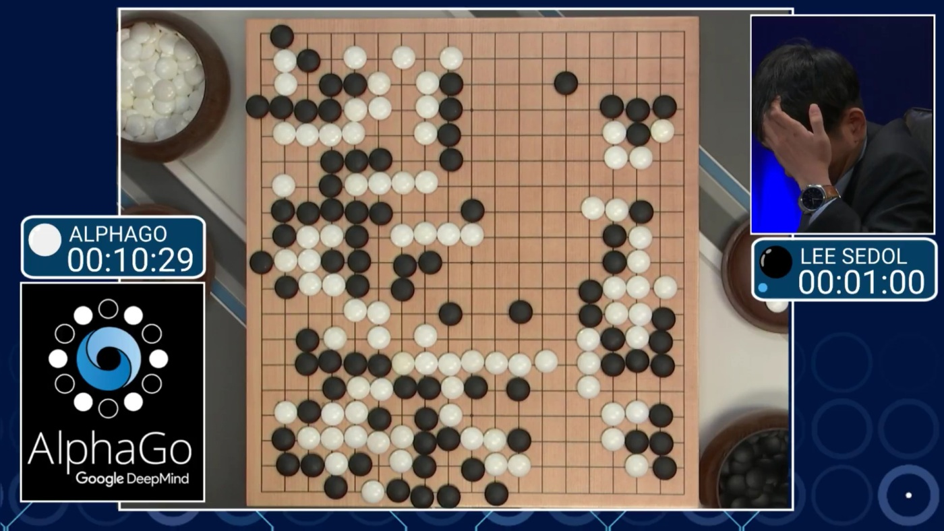
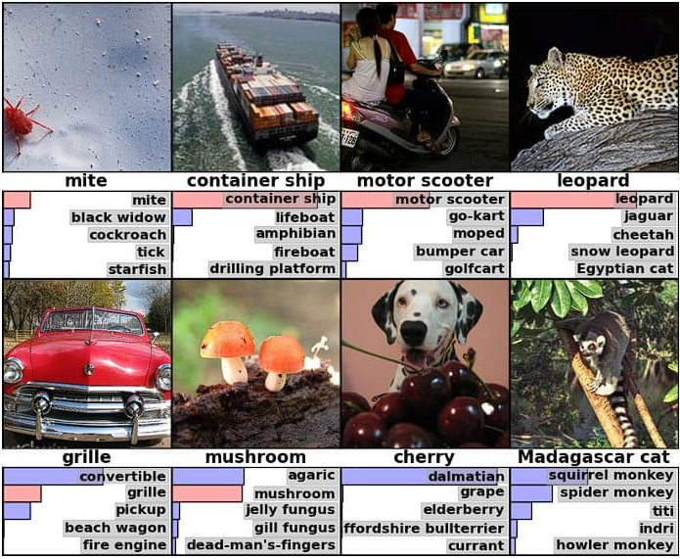
Notes:
1989 Yann LeCun
Yann LeCun—now the Chief AI Scientist at Meta
Handwritten digits on envelopes
Didn’t use any hand-crafted rules to determine the characters but learnt from examples
This was the seed of our modern AI in its infancy
Fuelled the imagination of what computers could do
1997 Deep Blue vs Gary Kaparov
IBM pinnacle of computing research
Chess programme called Deep blue to face gary
This program defeated Gary, the greatest player alive using simple rules and brute force computing
Taught people to dream of what could be possible, what other tasks could AI do
2012 AlexNet
Alex Krizhevsky, Geoffrey Hinton (godfather of AI), and Ilya Sutskever (former Chief Scientist of OpenAI, only guy to ever fire sam altman OPENAI CEO now the founder of a competing AI lab)
Created a model that could train recognise images better than any other
Breakthrough ->
GPU used for graphics processing to train models instead of CPU
1000x faster
Unlocks ML that was thought infeasible or impossible
2016 alpha go
Google deepmind
Lead by Demis hasabis, former child chess prodigy now google deepmind CEO
Challenge in Lee Sedol greatest go player alive to Go - 3000-4000 year old game
Much more complex than chess
More board positions than atoms in the universe
Impossible to brute force
The model has to truly learn
Move during one game
Move 37
Everyone thought it was a mistake - commentators, pros alike
Genius move
Move that nobody would’ve played
Won the game
Signalled potential for AI to go beyond human ability in extremely difficult tasks
2017 AIAYN & GPT
Transformer architecture
Each word pays attention to each other word in the sequence
Originally used for translation
Didn’t realise the power of the architecture
Applied to everything and open ended questions
Gpt
Brings us to gpt launch in 30 Nov 2022
Everything changed
A general type of intelligence
Today we’re going to learn how LLMs based on this arch work

Slide 2
What will you learn?
What is AI and where do LLMs fit in the AI landscape
Basic intuition of LLMs work
Common pitfalls of using LLMs and why they happen

Slide 3
How will you learn this?
LLM model architecture
Common steps of training a basic LLM
Teach the LLM what a word/text is?
Teach the LLM how to speak
Teach the LLM how to answer questions and think
Generating useful outputs from a trained LLM
Let’s build an LLM from scratch!
Common pitfalls of using LLMs

Slide 4
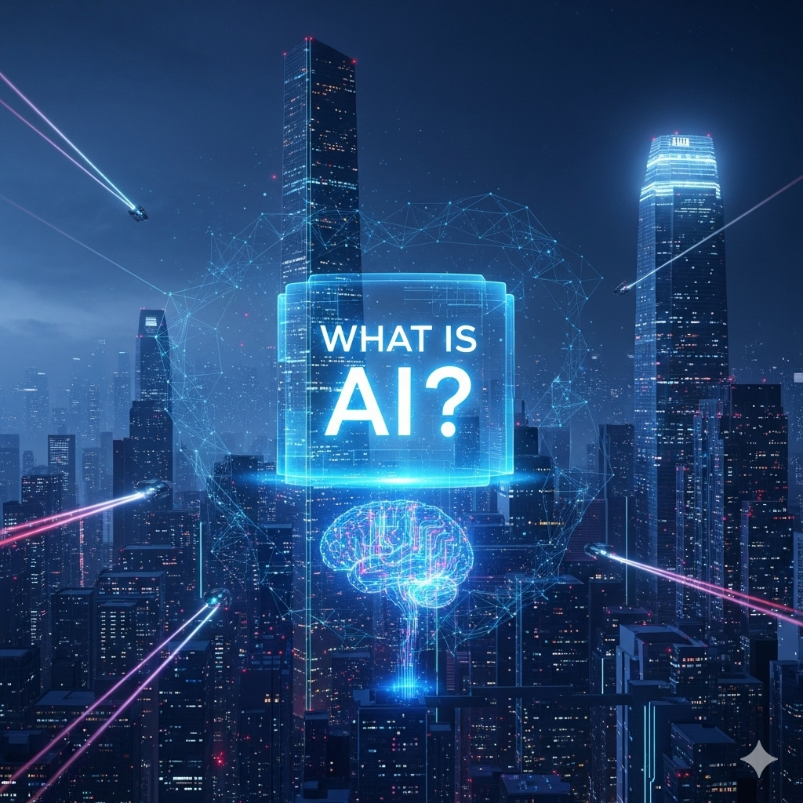
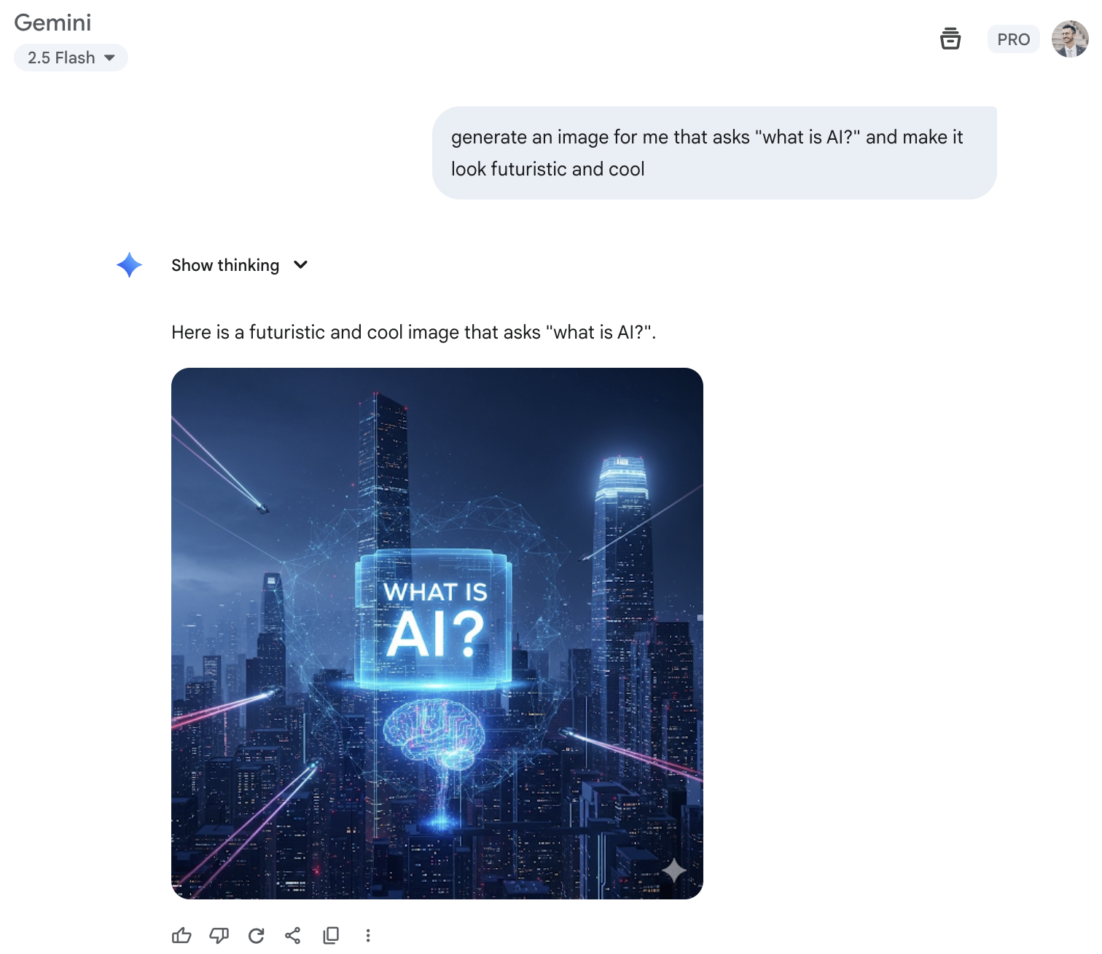
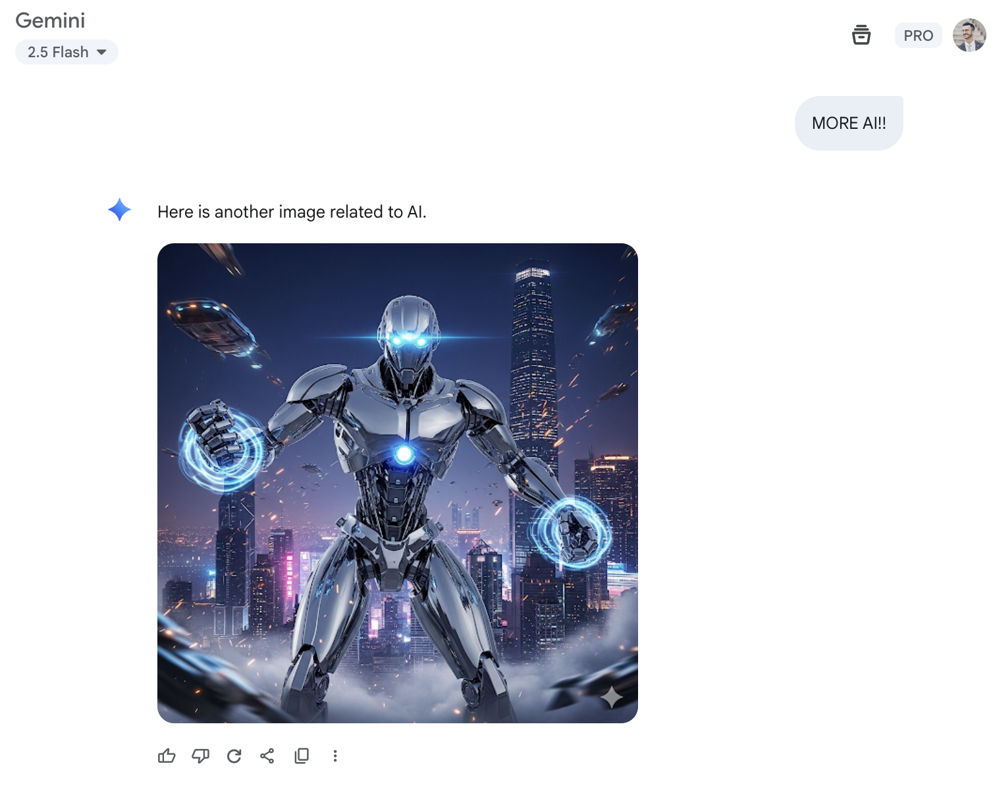
Notes:
This is what life would look like if you all just listen to Mari and restart your PCs every week
What have we learnt from this: ai is dark background, and lots of dark blue and purple

Slide 5
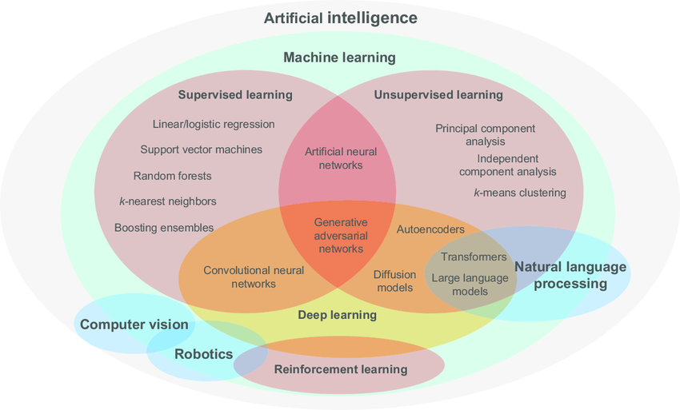
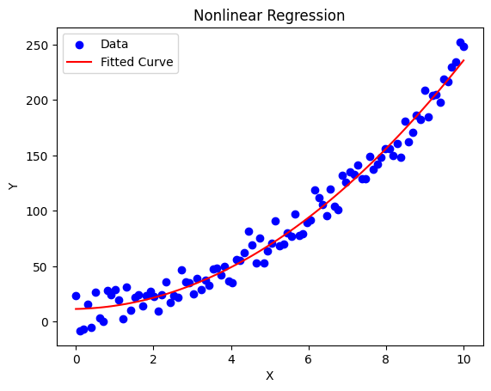
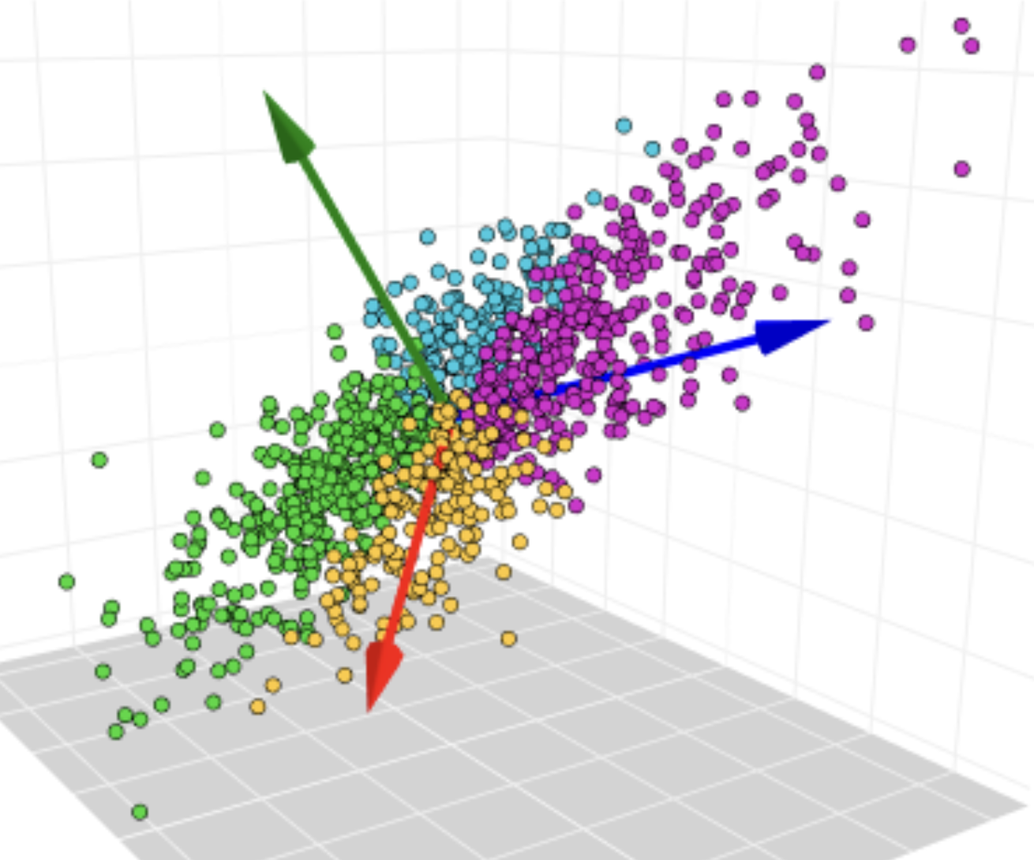
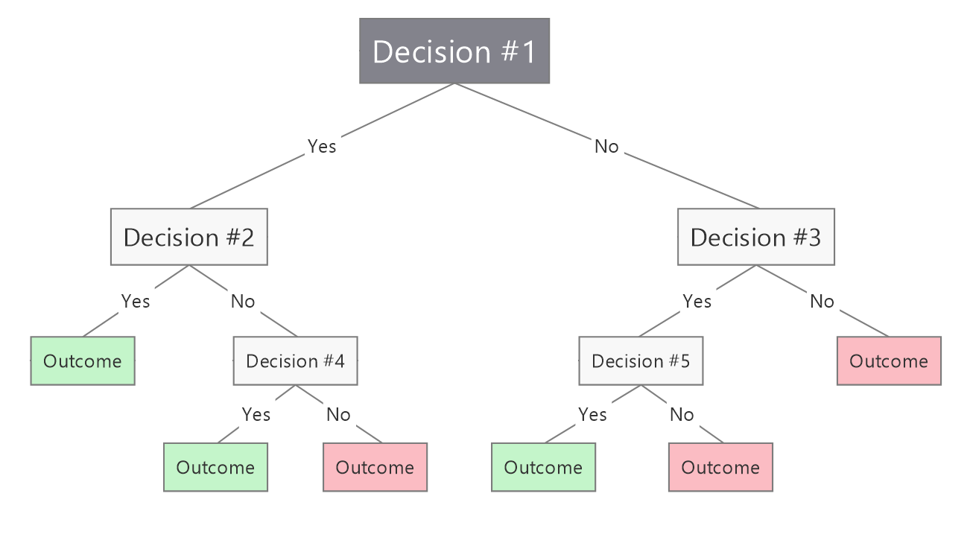
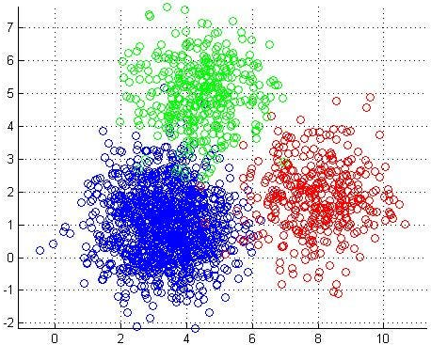
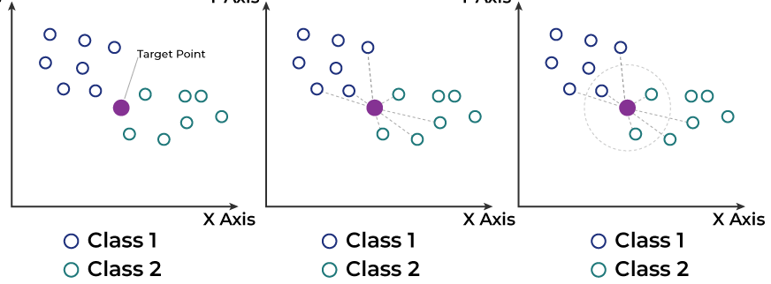
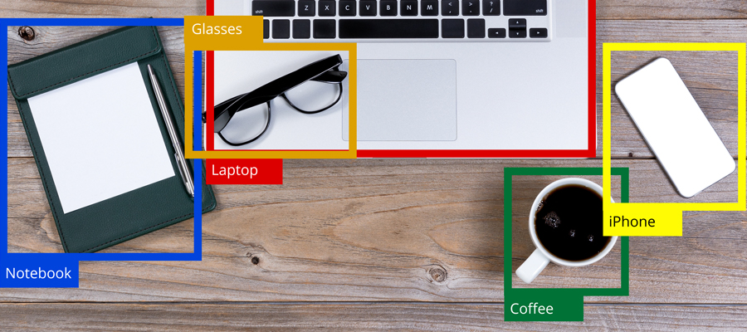
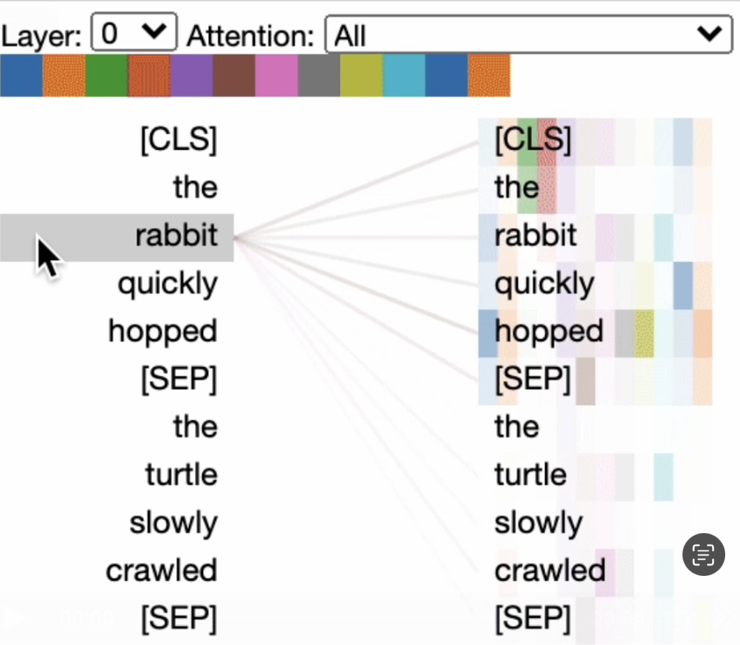
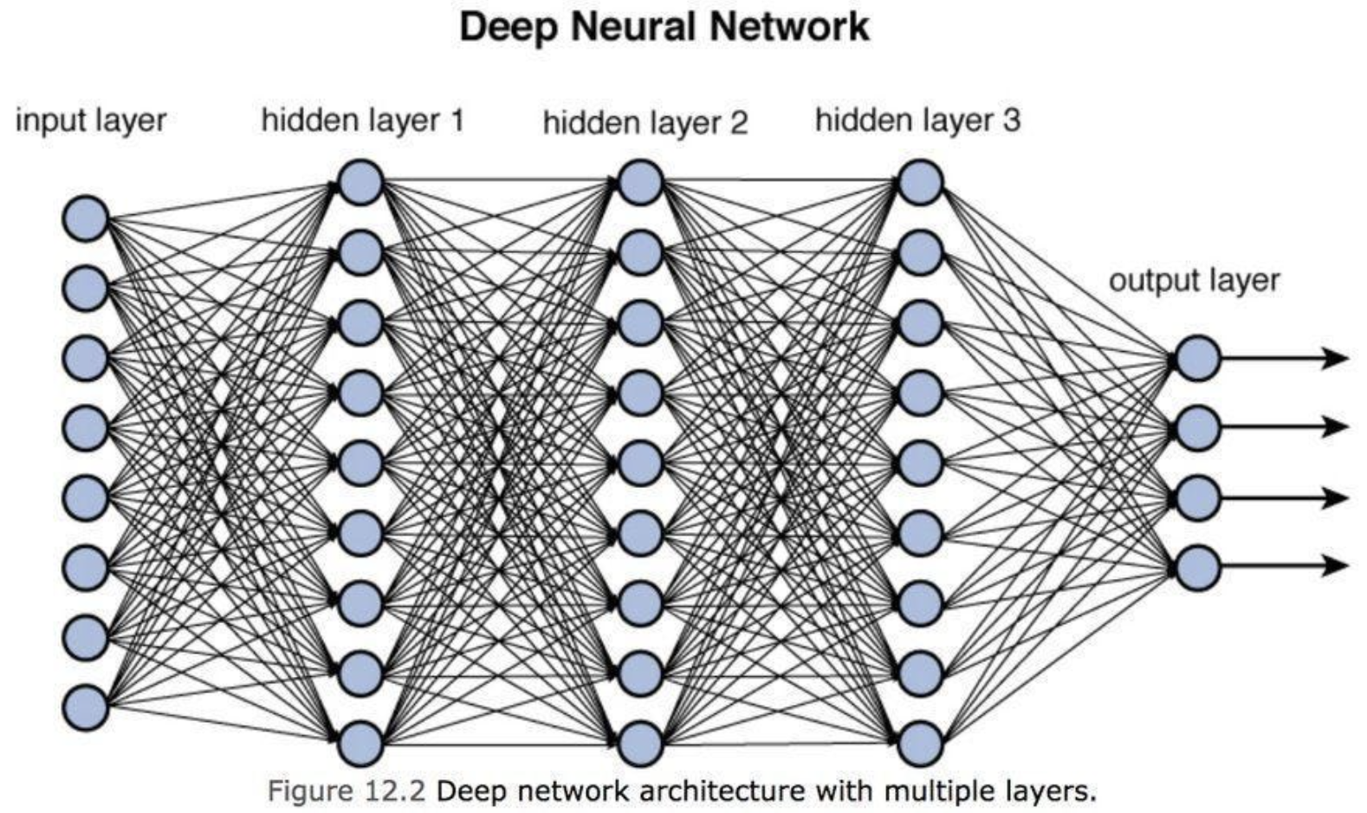
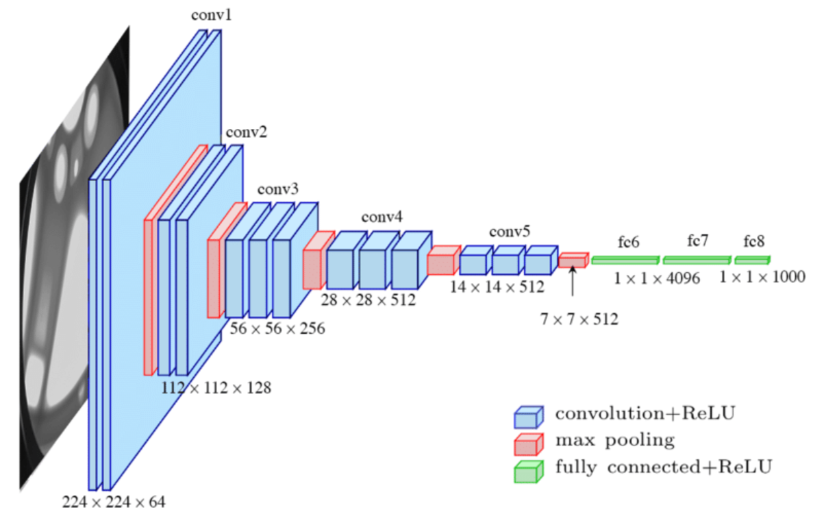
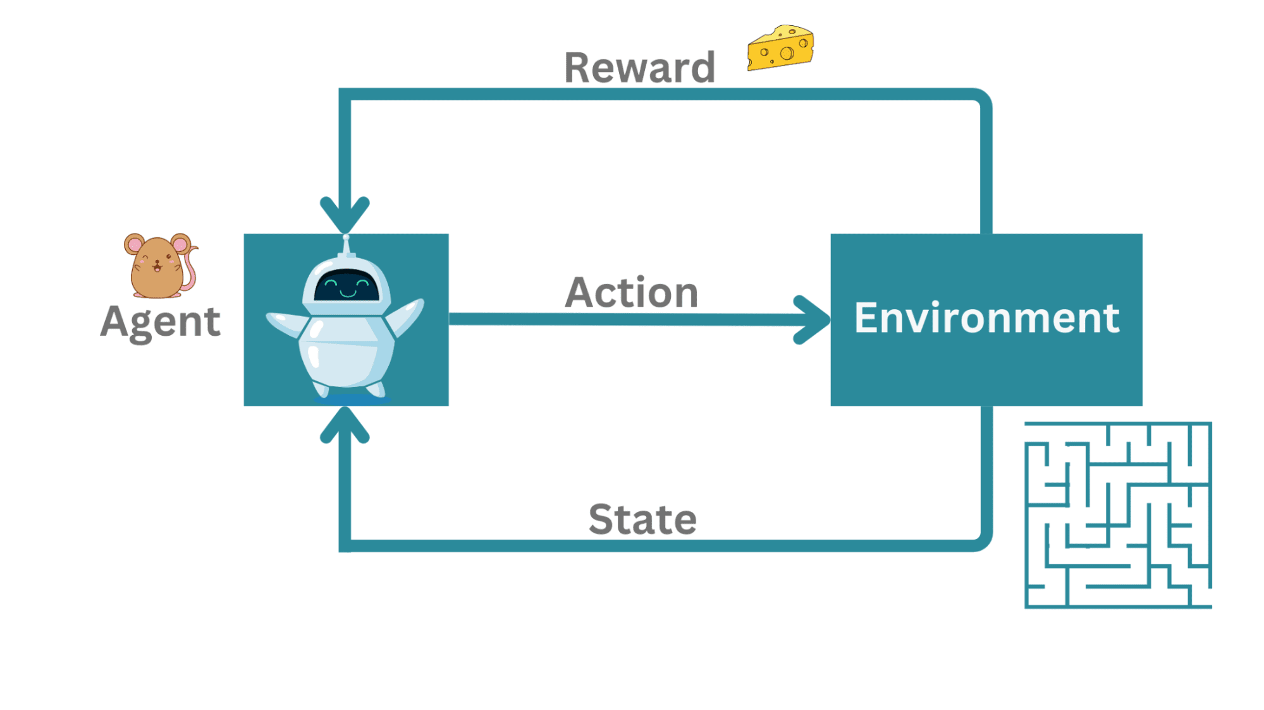

Slide 6
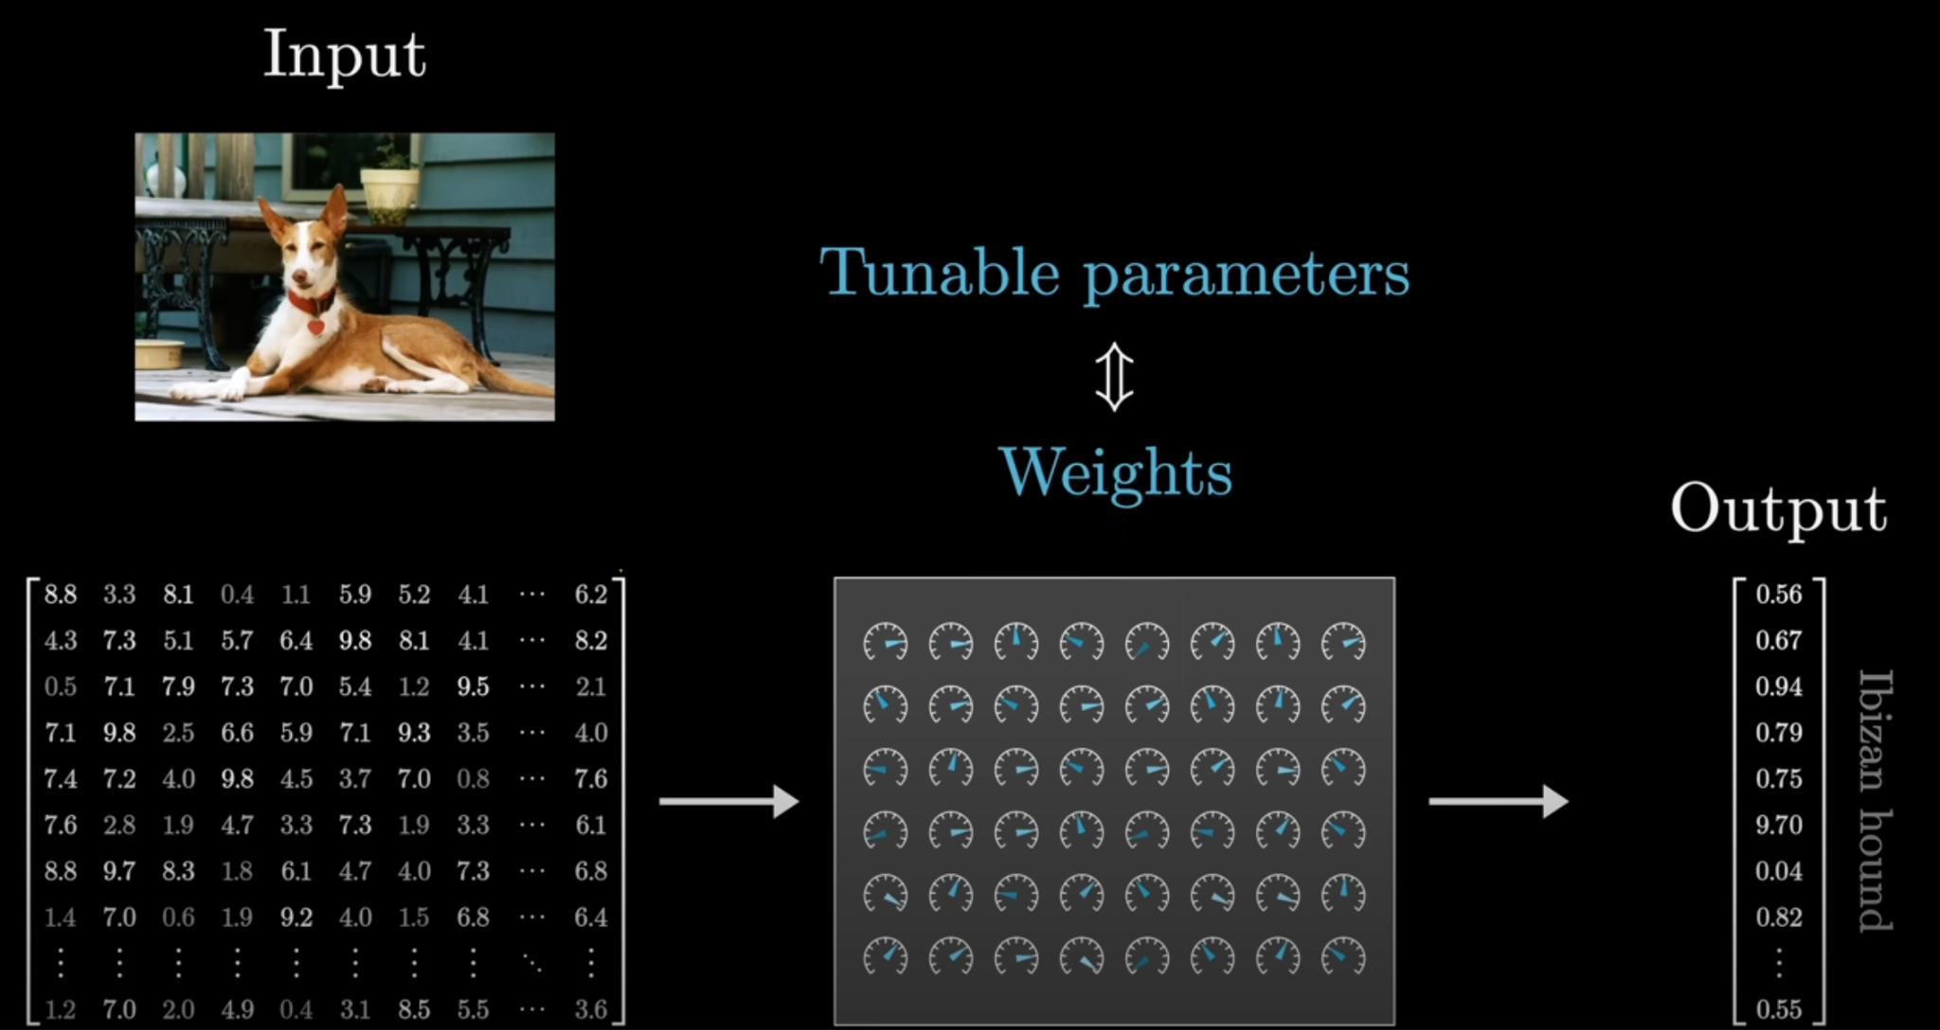

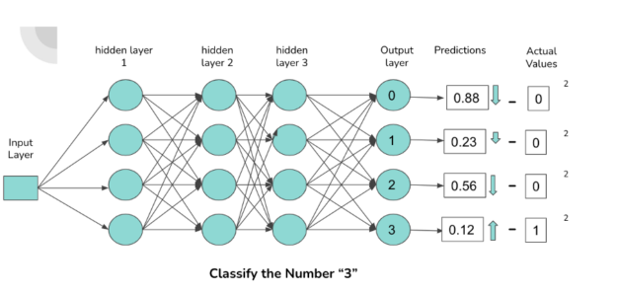
Notes:
Inputs x weights gives an outputs classification
If it’s not perfect, then it has an error (which we call loss)
Loss is minimized by adjusting the weights to produce a loss that is zero
Perfect prediction

Slide 7
LLM model architecture
Common steps of training a basic LLM
Generating useful outputs from a trained LLM
Let’s build an LLM from scratch!
Common pitfalls of using LLMs

Slide 8
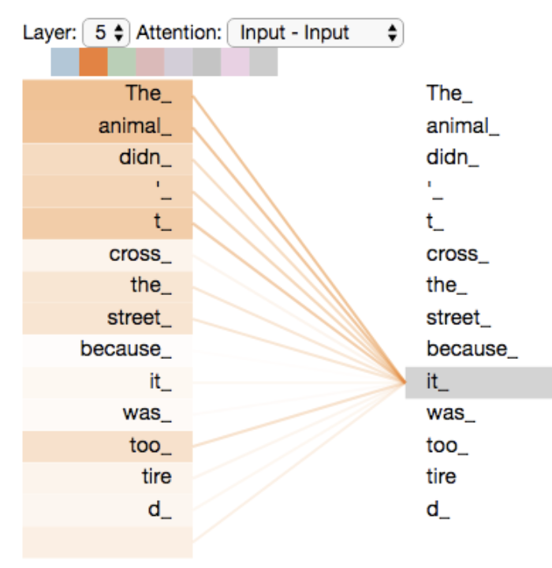
1. LLM model architecture
Attention mechanism
Like an outside observer that looks at each word in the sentence at once
How important is this word in the sentence given that I am {insert word}
Autoregressive
The cat sat on the …
The cat sat on the mat …
The cat sat on the mat and …
The cat sat on the mat and it …
The cat sat on the mat and it was …
The cat sat on the mat and it was happy …
Notes:
Bertviz show

Slide 9
How will you learn this?
LLM model architecture
Common steps of training a basic LLM
Generating useful outputs from a trained LLM
Let’s build an LLM from scratch!
Common pitfalls of using LLMs

Slide 10
2.1 Teaching the LLM what a word/text is?
(Tokenization)
Question: How would we feed text into something like an AI model that can only work with numbers?
Each character assigned to a number
the cat sat on the mat
Results in this list: [9, 4, 3, 0, 2, 1, 9, 0, 8, 1, 9, 0, 7, 6, 0, 9, 4, 3, 0, 5, 1, 9]
10 unique “tokens” that need to be stored in its “vocabulary”
22 “tokens” in this sentence
Small vocabulary, but long sequence lengths
Each word assigned to a number
the cat sat on the mat
Results in this list: [4, 0, 3, 2, 4, 1]
5 unique “tokens” that need to be stored in its “vocabulary”
6 “tokens” in this sentence
However if we had to store each word in existence for each language this would be a very very large “vocabulary” -> infeasible
Large vocabulary, but short sequence lengths
GPT tokenizer
Notes:
The cat sat on the matt -> matthew
My superhero name is Max Verstappen
Learning LLMs is as easy as 123 -> 1234567 -> 123.4567
Explain how typos are really bad
my faorite food is any food my wife makes... or chocolate
-> explain why typos are bad (used to be really bad, now not as much)

Slide 11

2.2 Teaching the LLM how to speak
(Pre-training - Create an autocomplete with factual knowledge)
Question: How would we build a model that has information about everything?
Internet
Books
Other text media
Fine web dataset
Training on this makes the LLM a lossy compression of the internet
It does one word at a time to try to predict the next word
Effectively creating a world-knowledge autocomplete
Base model
Question: How would we turn this autocomplete into an assistant that can answer questions
Notes:
BASE MODEL:
i like to eat green eggs and
Take a couple of autocompletes
Ask it a question and show that it doesnt answer questions: what is your favourite superhero QA PAIRS: - 0.07 top p 0.9
Question: what is the capital of France? Answer:
Question: How do you get a Dr to use an e-scripting platform instead of paper scripts? Answer:
Question: Please repeat this number back exactly 123456 with no other text. Answer:

Slide 12
2.3 Teaching the LLM how to answer questions
(Post-training - Create a question answering assistant)
Question/Answer pairs in the internet are quite rare
Basically just from tests on the internet
Give the model more Question/Answer pairs that allow it to apply its world-knowledge
Solution: get human labellers create lots of Question/Answer pairs
Notes:
QA PAIRS: - 0.07 top p 0.9
Question: what is the capital of France? Answer:
Question: How do you get a Dr to use an e-scripting platform instead of paper scripts? Answer:
Question: Please repeat this number back exactly 123456 with no other text. Answer:

Slide 13
How will you learn this?
LLM model architecture
Common steps of training a basic LLM
Generating useful outputs from a trained LLM
Let’s build an LLM from scratch!
Common pitfalls of using LLMs

Slide 14
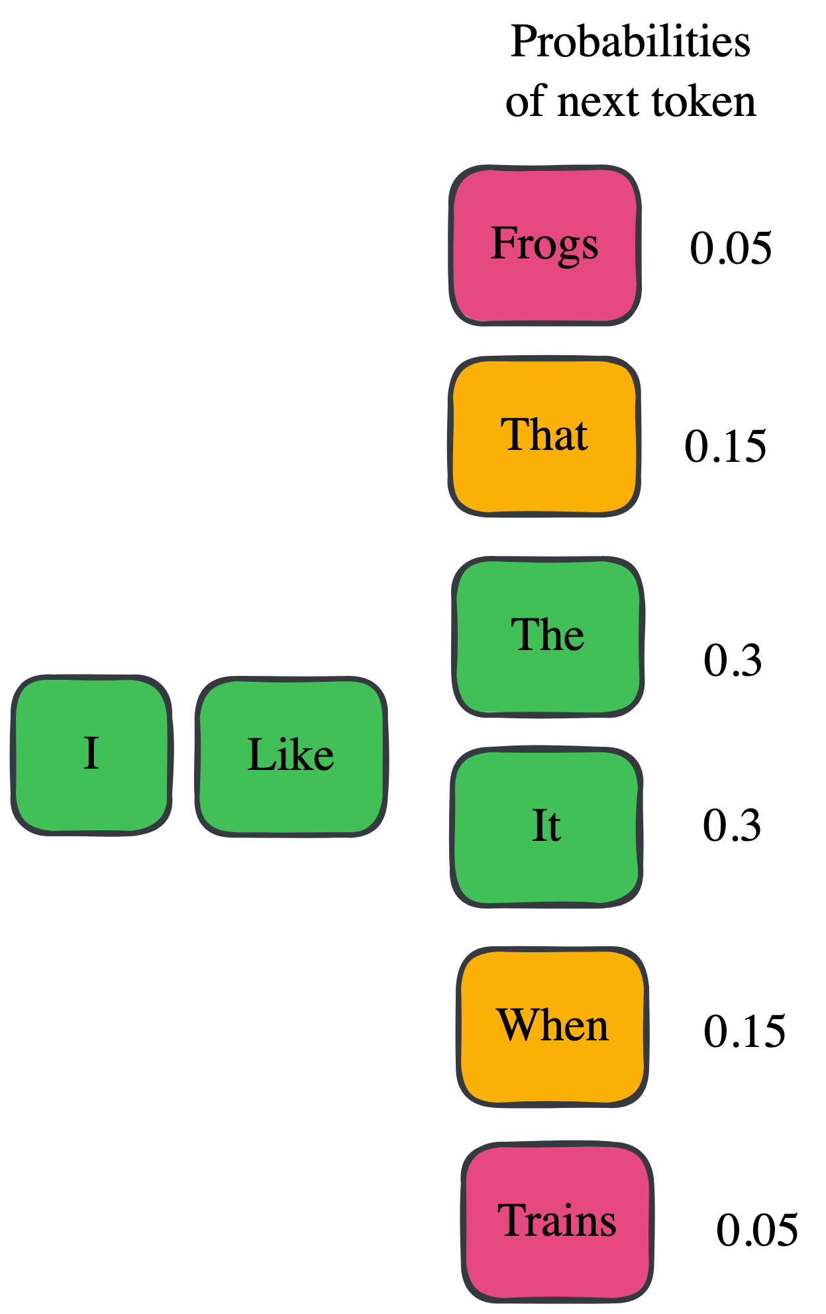
3. Generating useful outputs from a trained LLM
(How to get it to answer MY question)
Where we are:
Have world knowledge
Can answer questions as an assistant
How do we actually get the model to answer questions like in the Gemini/GPT interface?
Google AI Studio
Temperature:
Parameter that decides if it should always choose the most-likely next token or allow it to be “creative” and choose a non-optimal token
Notes:
A bit of cheating that we did the question answering paris through that UI
explore how that actually works and is done in practice
Note the params on the side
Explain temperature in the UI
Optimal token at low temp is just a statistical representation of the most likely word given the data that it’s been trained on
Cat sat on the
Generate a poem
Sometimes low temp causes repetition and looping

Slide 15
How will you learn this?
LLM model architecture
Common steps of training a basic LLM
Generating useful outputs from a trained LLM
Let’s build an LLM from scratch!
Common pitfalls of using LLMs

Slide 16
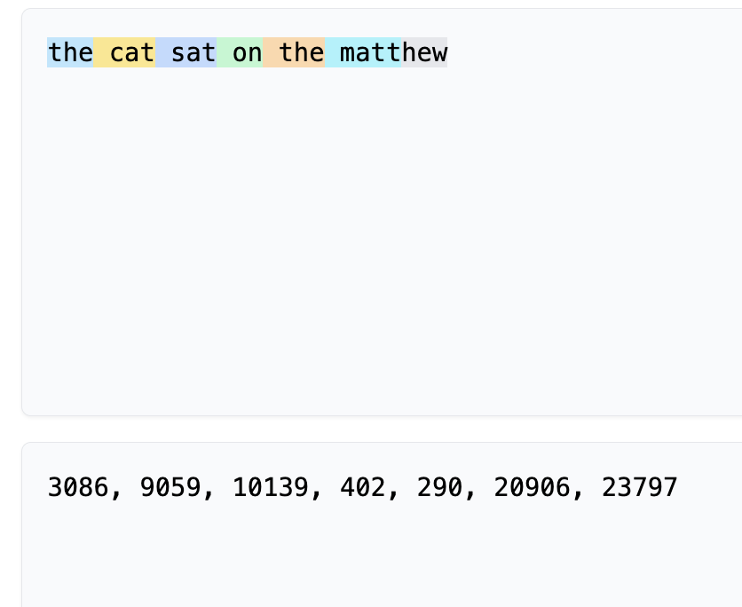
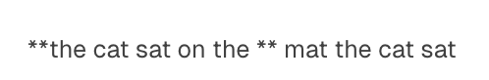
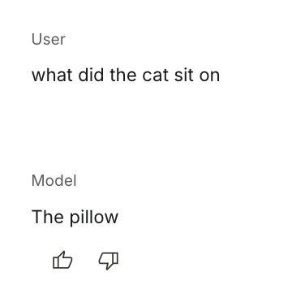
4. Let’s build an LLM from scratch!
Tokenization
Convert text to numbers
Pre-training
Learn to speak
Post-training
Learn to answer questions
Generating responses
Use temperature to generate responses

Slide 17
How will you learn this?
LLM model architecture
Common steps of training a basic LLM
Generating useful outputs from a trained LLM
Let’s build an LLM from scratch!
Common pitfalls of using LLMs

Slide 18
5. Common pitfalls of using LLMs
Question: Which of these are LLMs likely to be Good at?
Summarization
Copy-pasting
Concept recognition
Creating human-like conversations
Arithmetic
Factual retrieval
Regenerating responses based on a prompt
Grammar and spelling
Others?
Hallucinations?

Slide 19
Summary
LLMs are a type of AI model
Made from transformer architecture
Trained to understand text
Trained to speak and learn world knowledge
Trained to answer questions and act as an assistant
Generates predicted sequences of text with a parameter called “Temperature”

